Slide 1
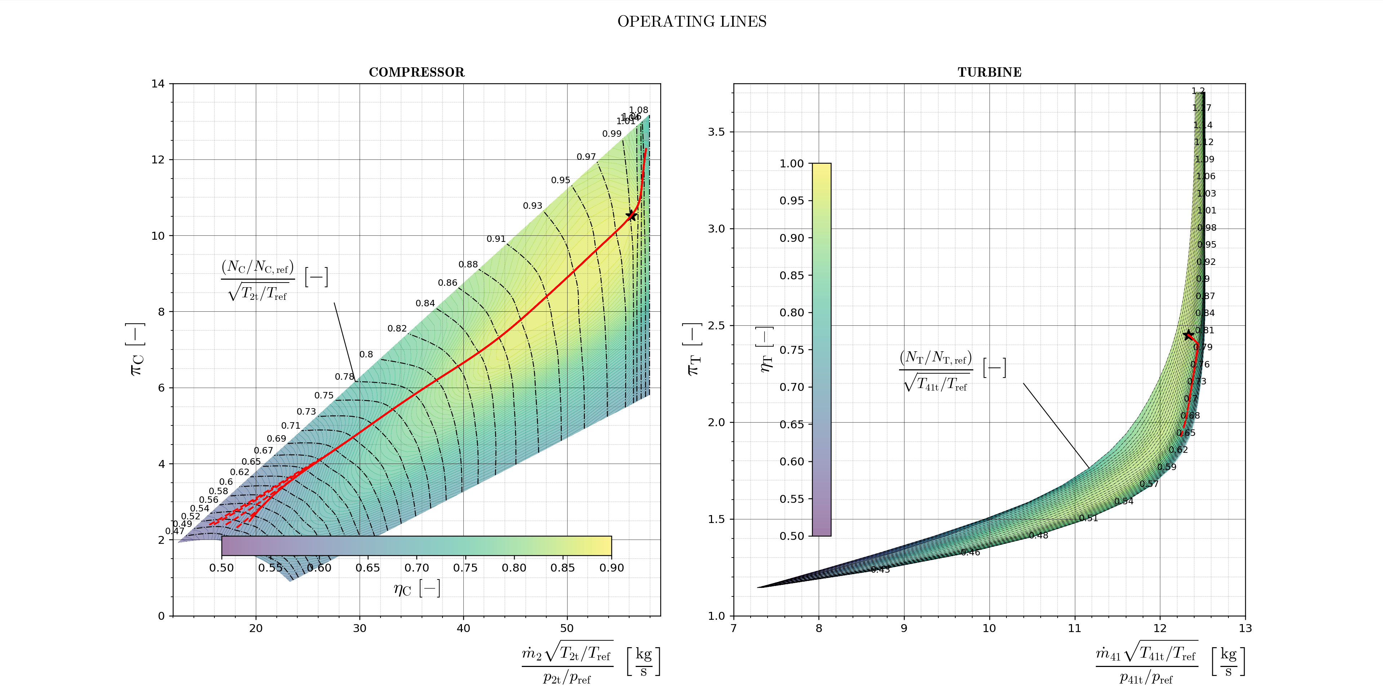
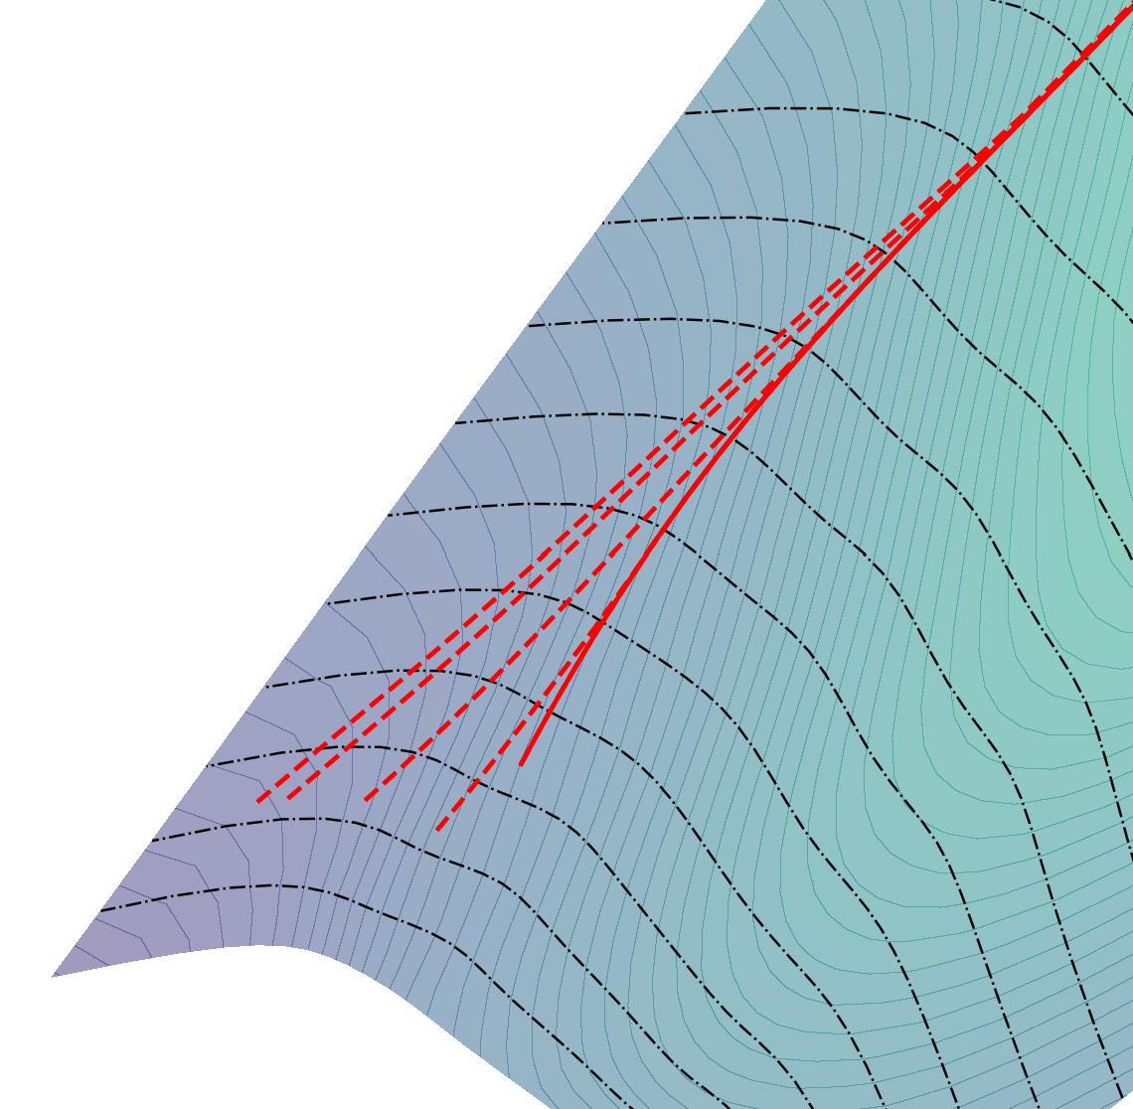
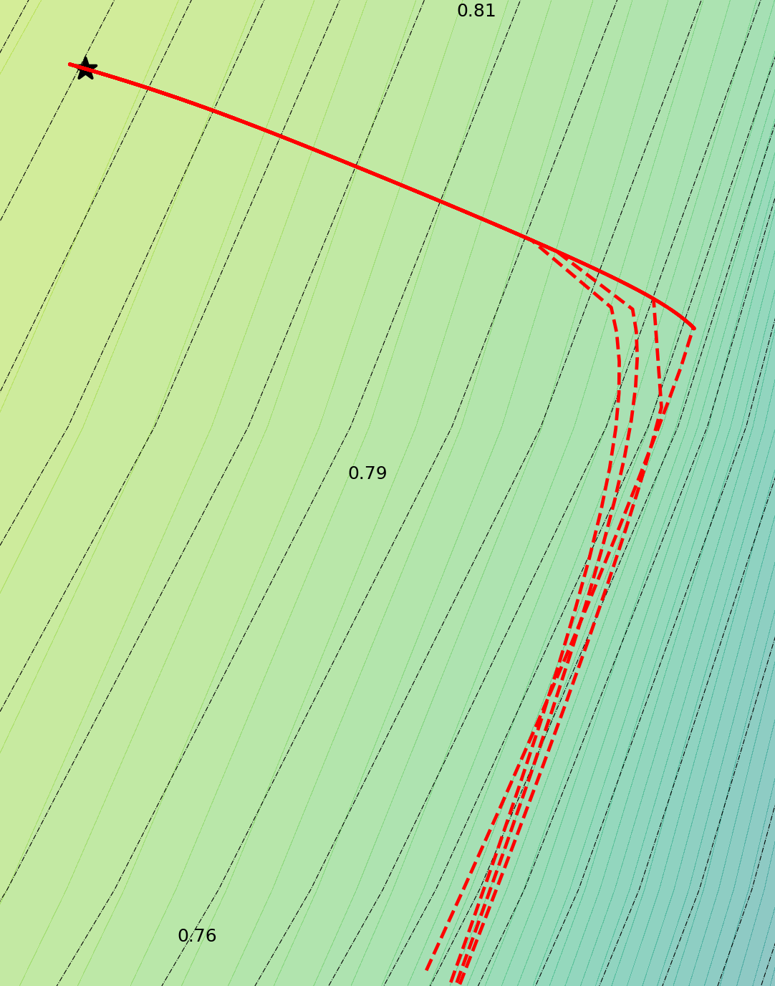





CHOKED NOZZLE SUBSONIC NOZZLE
M₀ $[−]$
M₀$[−]$
M₀$[−]$
$$\frac{\left(N_{C}/N_{C,ref}\right)}{\sqrt{T_{2t}/T_{ref}}} [−]$$
0.25
0.0
0.5
1.0
0.0
0.5
1.0
0.25
0.75
0.75
$$\frac{{(N}_{T}/N_{T,ref})}{\sqrt{T_{41t}/T_{ref}}} [−]$$

